Slide 1



Scalable Integration of Heterogeneous Financial Data and Programming
A world of financial data, at your fingertips
Dr. Don Syme
Principal Researcher, Microsoft Research
F# Community Contributor, @dsyme

Slide 2
Proposition 1 The world is information-rich

Slide 3
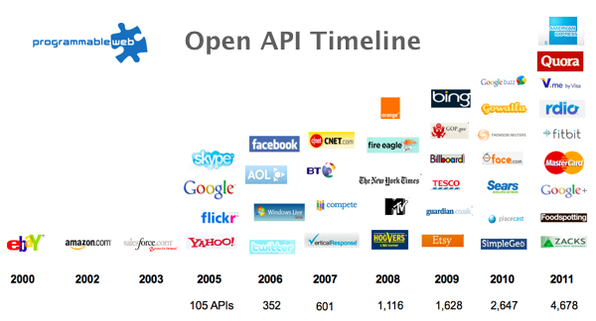
The Information Revolution
2012
2013
6,432
10,537

Slide 4
Proposition 2 Modern financial programming is intensely information-rich

Slide 5
Proposition 3 Our financial programming languages are information-sparse

Slide 6

Financial data is like water…

Slide 7
Financial data is like water…
Everyone needs it. Everyone knows where to get it. Simple.
But…
…nobody is sure where it really came from, or goes to.
… nobody really knows its true cost, or true value.
… nobody likes to pay for it, or to share it.
… nobody knows how much is wasted
… nobody knows a good plumber
… nobody knows how bad it is until after you have drunk it

Slide 8

Actually these days it’s more like a flood…

Slide 9
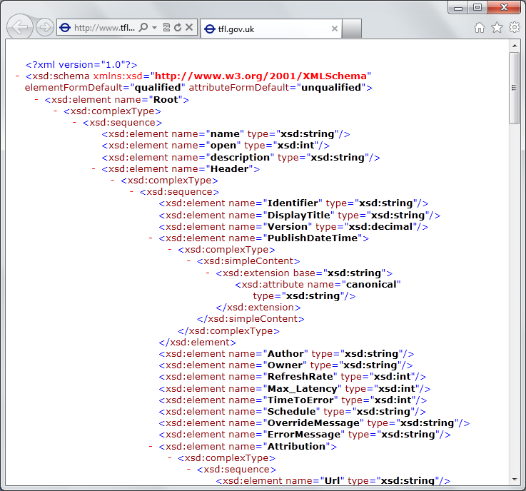
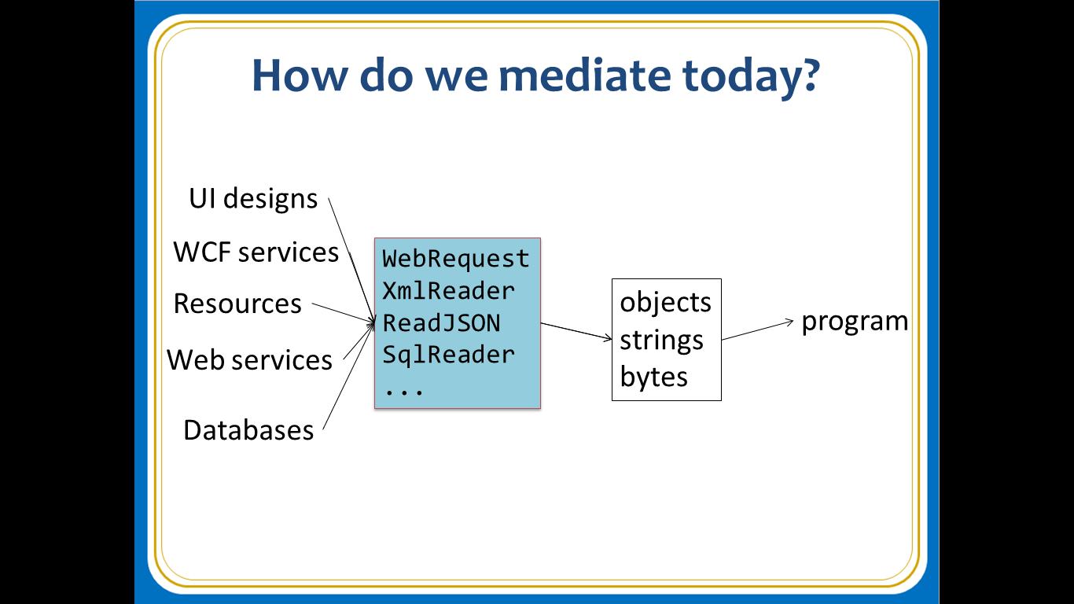
The data plumber’s perspective
Languages do not integrate information
Weakly typed
Not at scale
Non-intuitive
Not simple
Disorganised
Static
High friction

Slide 10
For all financial programming scenarios, we need to bring financial information into our data plumbing languages… At market-scale, in-cloud or on-premise, strongly tooled, strongly typed

Slide 11
But before we get into that…

Slide 12
This R&D is done in the context of the open language F#
Lots of good reasons for that, see our tech report
“Strongly Typed Language Support for Internet-Scale Information Spaces”

Slide 13
F# is a great data plumbing language

Slide 14
F# is open source, cross platform fsharp.org

Slide 15
F# has a fabulous, fun, vibrant, intelligent, contributing community fsharp.org fsharpforfunandprofit.com

Slide 16
F# helps address real human and technical problems around Time to Market, Efficiency, Correctness and Tackling Complexity

Slide 17
F# has a particularly strong following in finance, including leading London-based banks and hedge funds fsharp.org/testimonials

Slide 18
F# is used for real to make lots of money fsharp.org/testimonials

Slide 19
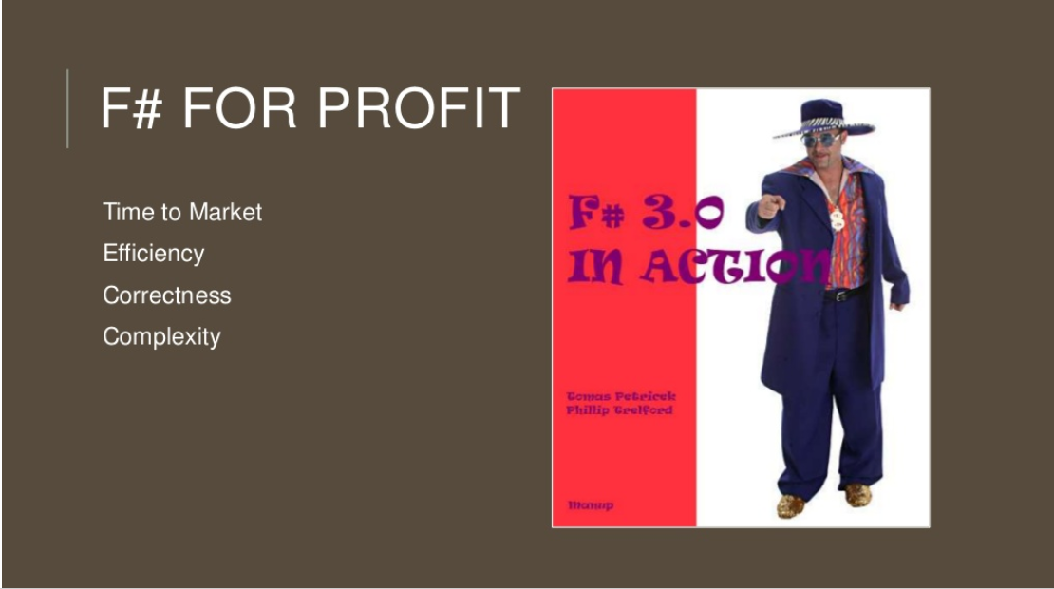

Slide 20
Example: F# for Quant Consulting
Complexity
Our bids for tendered contracts in quantitative finance are regularly half the price of competitors because of the increased productivity we get from F#.
We are regularly able to deliver correct, robust, performant solutions on-time, which is what our customers value most.
Daniel Egloff, QuantAlea Consulting, Zurich
Efficiency
Time to Market
Correctness
http://fsharp.org/testimonials

Slide 21
Microsoft recommend F# and the Visual F# tools for your functional-first programming needs

Slide 22
Back to the main topic…

Slide 23
F# Topics
F# Basics
F# for Cloud Data
F# for DSLs in Risk and Insurance
F# for GPUs
F# for Pricing
F# + R
F# for Data Science
F# Deep Data Integration

Slide 24
The Problem We’re Addressing Our data plumbing tools are data-sparse getting financial data into a programming language is tiresome, error prone and boring

Slide 25
We need to bring financial information into the language… At market-scale, strongly tooled, strongly typed

Slide 26
Which data? Xenomorph Timescape is Microsoft’s preferred partner for Financial Data in the Azure Cloud Platform
Data like this enables entire cloud industries

Slide 27
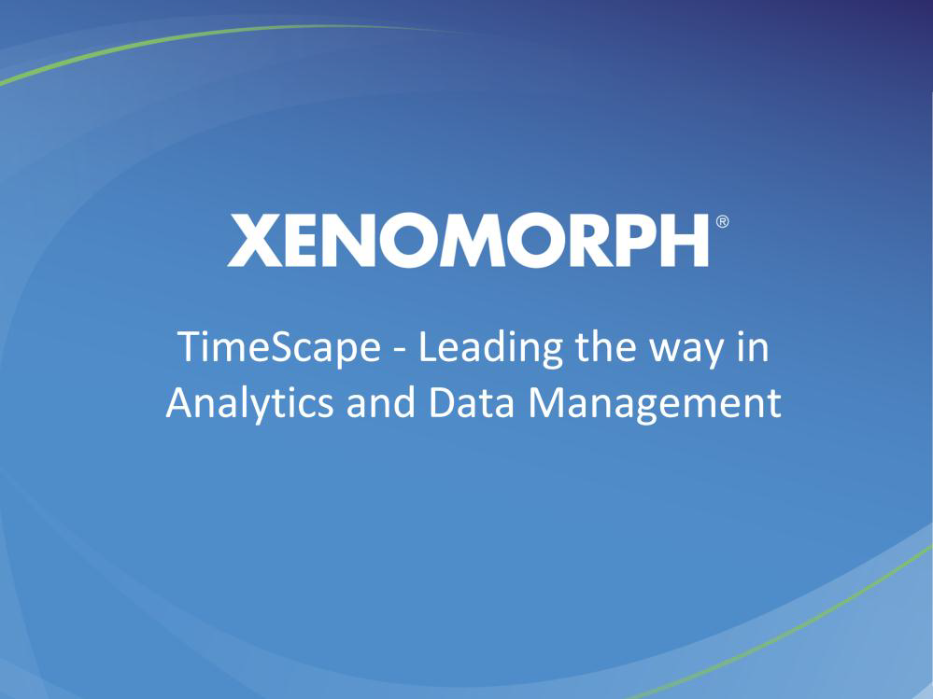

Slide 28
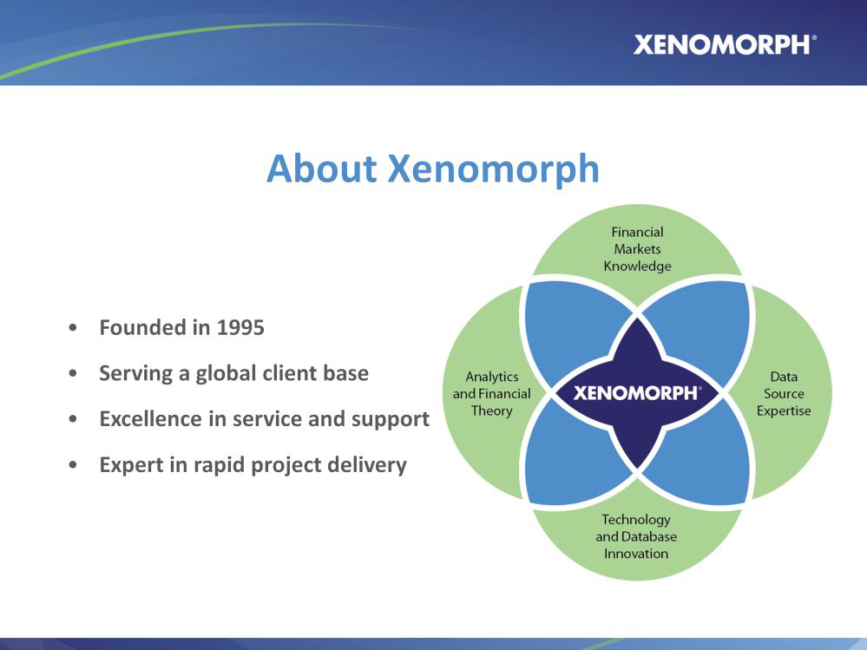

Slide 29
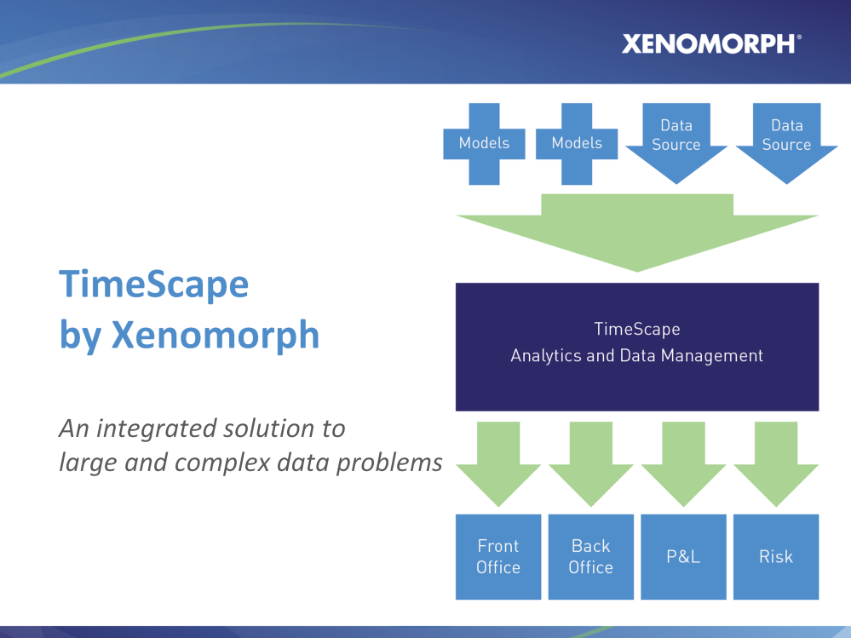

Slide 30
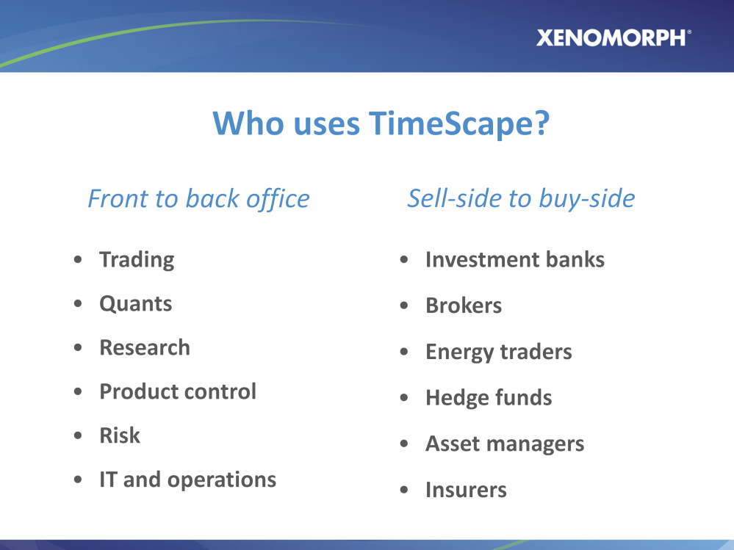

Slide 31
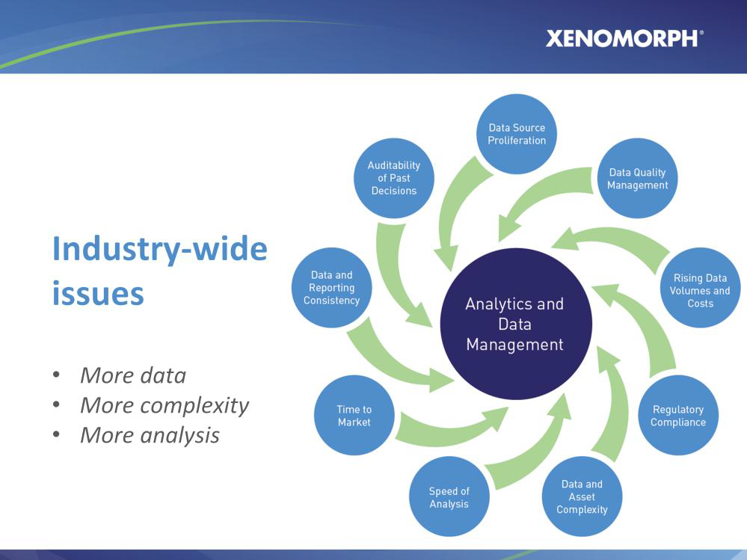

Slide 32
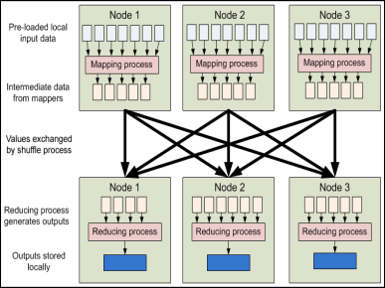


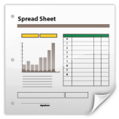
Data Provider
Data Provider
Data Access Layer
Data Provider
Data Provider
Data Provider
Data Provider
Analytics
Provider
Analytics Provider
Data Analytics Layer
Data
Analytics Provider
HPC Server
Model Provider
Model Provider
Instrument Analytics Layer
Instrument
Analytics Provider
Query Layer
Layer
Layer
Third Party Services
Risk App
Trading App
Spreadsheet
Risk App
Trading App
Spreadsheet

Slide 33
The problem is this: the data is still weakly integrated into our data plumbing languages

Slide 34
The Technique: “F# Type Providers” Allow scalable, robust, deep integration

Slide 35
Similar Problem: Integrate all of freebase.com “as if it were a library” 40M entities, 1Billion facts, 24,000 types, 65,000 properties

Slide 36
Demo
F# + Freebase
An F# type provider for deep, robust integration of web data

Slide 37
A Type Provider is…. “Just like a library” “A design-time component that computes a space of types and methods on-demand…” “An adaptor between data/services and the F# type system…” “On-demand, scalable compile-time provision of type/module definitions…”

Slide 38
Demo
F# + Xenomorph TimeScape
An F# type provider for deep, robust integration of financial data

Slide 39
Theme #1 On-Demand Types = Internet Scalable Magic

Slide 40
On-Demand Type Provision
let data = RiskLab.GetDataContext()
1. Compiler/IDE requests metadata for symbol GetDataContext
Provider reports return type of RiskLabDataContext
data.Categories
2. Compiler/IDE requests contents of RiskLabDataContext and property Categories
Provider asks Freebase metadata service for top-level domains
Provider reports top-level domains of Freebase as properties of the type
data.Categories.``GB Equities``
3. Compiler/IDE requests metadata for symbol ``GB Equities``
...

Slide 41
Theme #2 Many Data Sources, One Mechanism

Slide 42
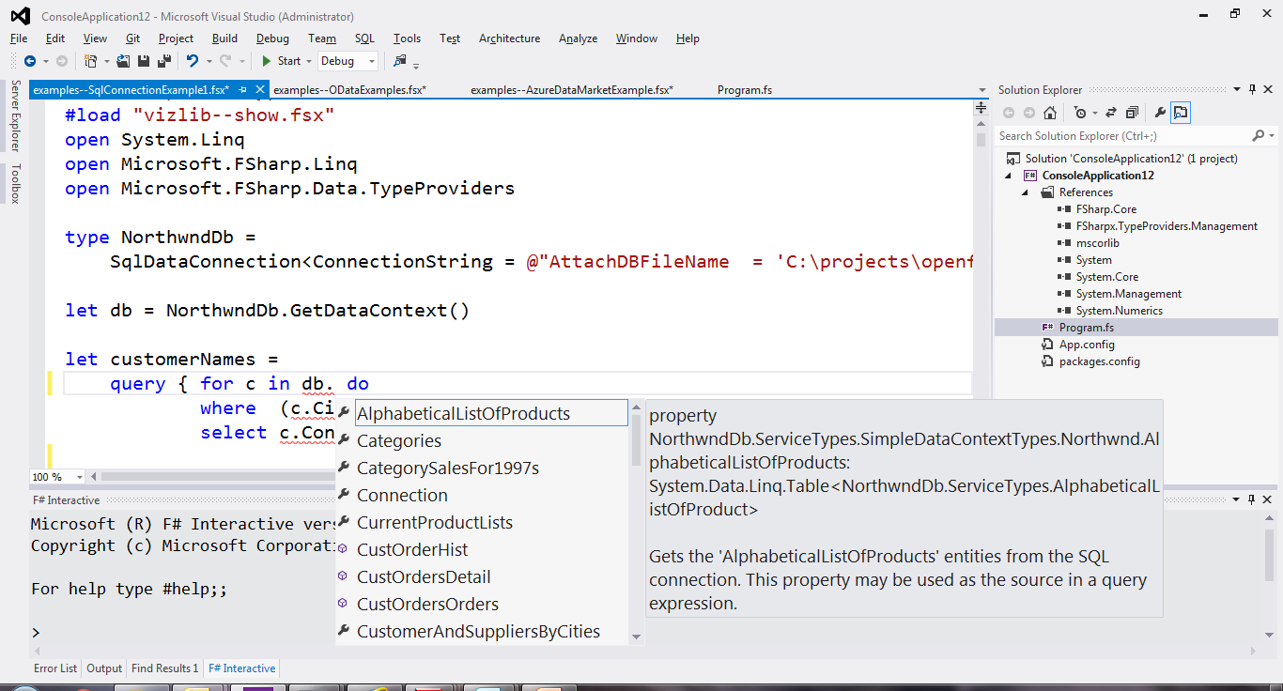
SQL

Slide 43
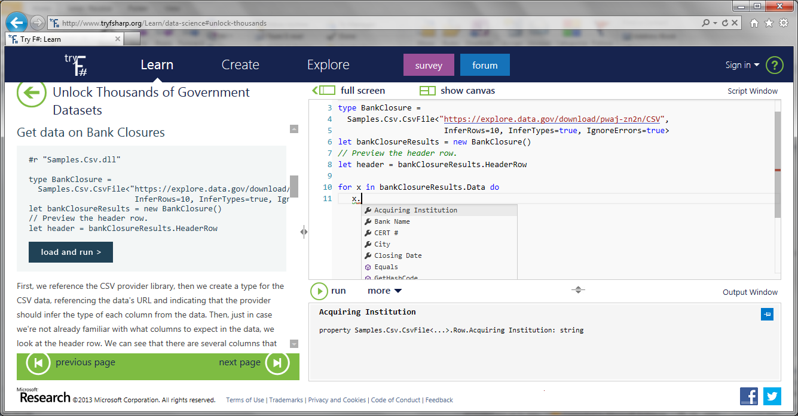
CSV

Slide 44
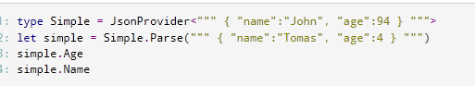
JSON

Slide 45
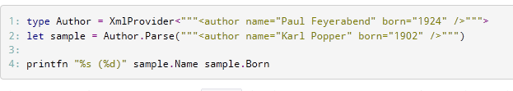
XML

Slide 46
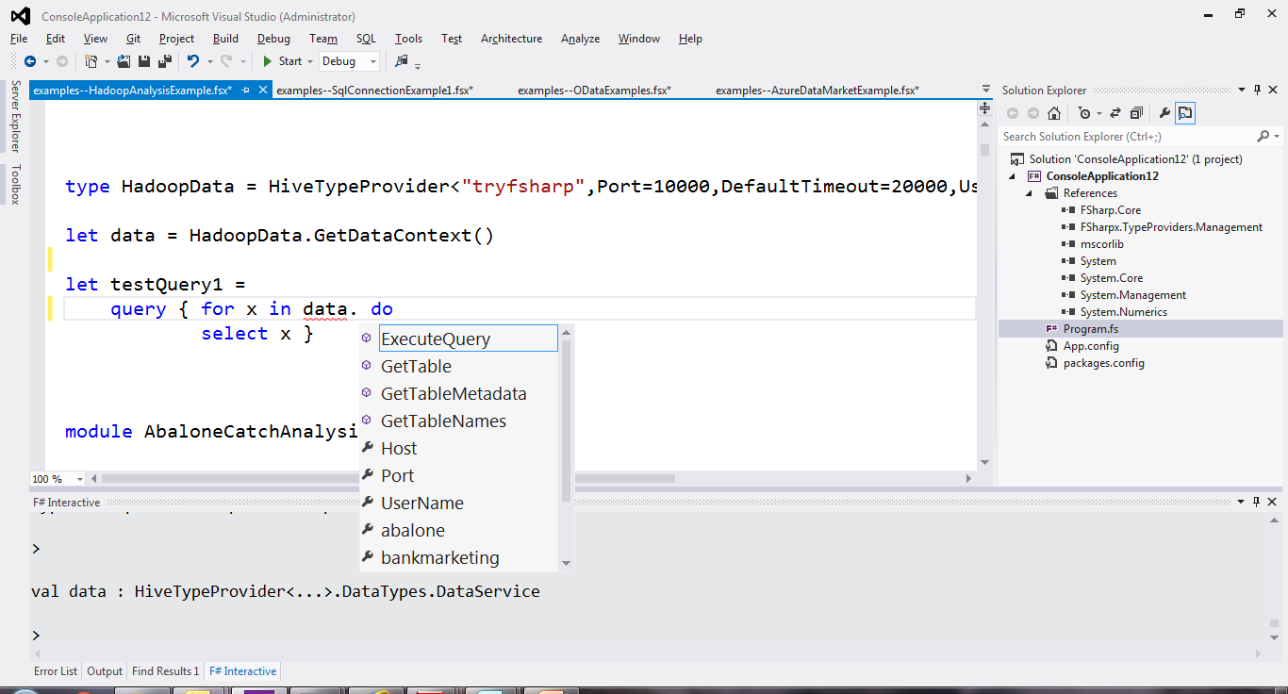
Hadoop/Hive

Slide 47
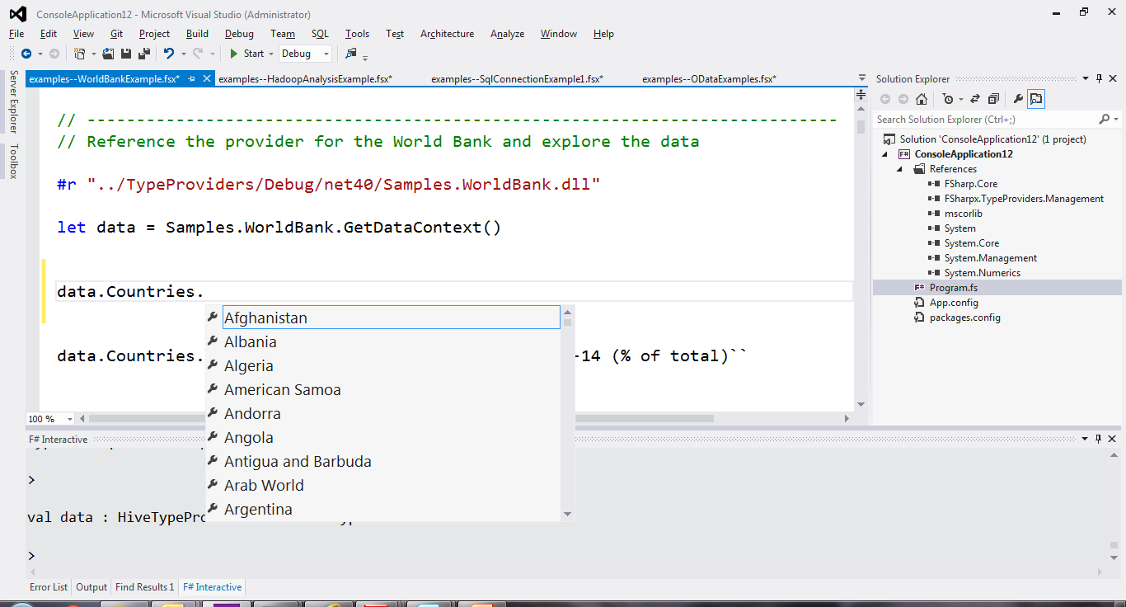
World Bank

Slide 48
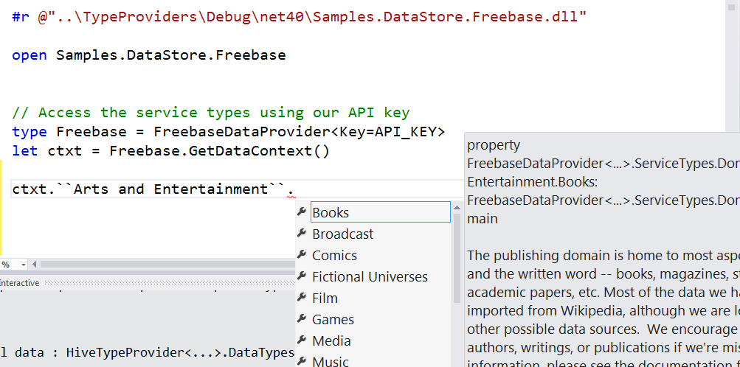
Freebase

Slide 49
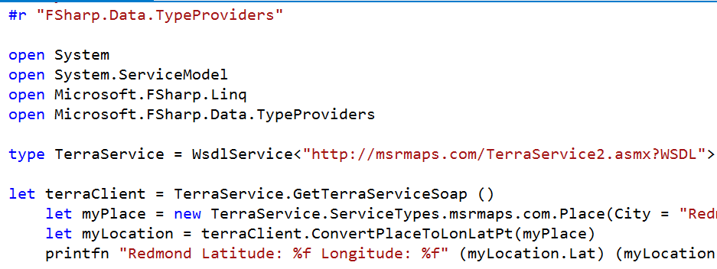
WSDL

Slide 50
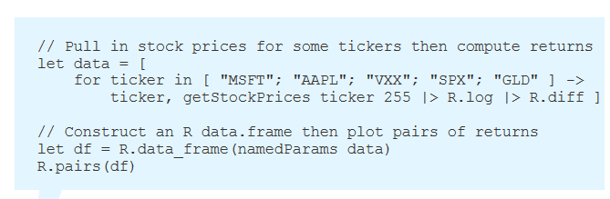
R

Slide 51
Demo
F# + R

Slide 52
Theme #3 Data and Types at Multiple Scales

Slide 53
Data at Multiple Scales
From Everything to Individuals
Data Scripters need to work with different granularities of schematization
data.AllEntites
data.Categories.``GB Equity``
data.Categories.``GB Equity``.``SAINSBURY(J) (SBRY.L, Reuters)``
…Only a language with massively scalable metadata integration can operate at all these levels
Every stable entity can get a unique type

Slide 54
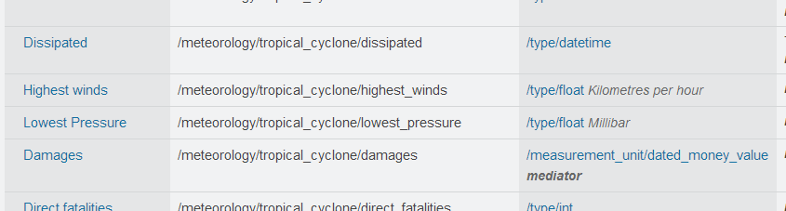
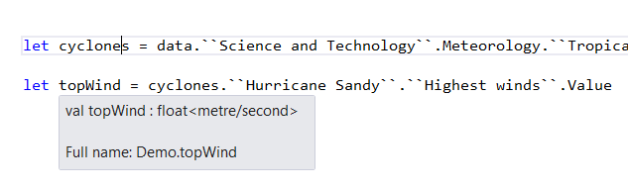
Providing Units of Measure
If the metadata contains units (including currencies)…
via F#’s Units of Measure
…then these can be projected into the programming language.

Slide 55
Theme #4 Queries Full XTS QL not yet supported in prototype Similar query languages (Freebase MQL) are well explored

Slide 56
Theme #5 Reaction, Asynchrony and Streaming Not covered today, but F# has excellent compositional primitives for reactive, streaming data, and provided data sources can easily make use of these

Slide 57
Some Research Questions Which Arise
Can we incorporate schema change policies?
Can historical and probabilistic metadata be useful for typing or tooling?
Can we provide all the data in the enterprise (e.g. Bloomberg and Reuters)?
Temporal types? Probabilistic types? Table types?
Can richer constraints, security, privacy and provenance annotations be provided?
Is there an interplay between provided metadata and machine learning models?

Slide 58
Summary
Financial programming is becoming ever more tightly integrated with data
Integrating data + programming has interesting research challenges
We have presented techniques for integrating many rich data/metadata sources in scalable, intuitive ways
You can use these techniques for real and in production through F#

Slide 59

Questions?

Slide 60
In Summary
F#
The safe choice for functional-first
Unbeatable data integration
Visual F# - tooling you can trust from Microsoft
Open, cross-platform, strongly typed, efficient, rock-solid stable

Slide 61
Theme #5 Schema Change

Slide 62
A problem, but…
Many, many data sources are surprisingly stable
Some data sources support “snapshot dates”
F# supports “invalidation signals” from providers at design-time
Erasure makes compiled code much less fragile

Slide 63
Functional-first programming is a general-purpose programming technique particularly suited to tasks where Time-to-deployment, Efficiency, Correctness and Taming Complexity dominate.

Slide 64
Examples include ETL pipelines, general data-manipulation, calculation engines, programmatic UIs and data science. While these problems can be solved using other programming paradigms, they are particularly amenable to functional-first programming.

Slide 65
Functional-first programming uses functional programming as the initial paradigm for most purposes, but employs other techniques such as objects and state as necessary.

Slide 66
The Recurring Business Problems
Time to Market
Efficiency
Correctness
Complexity
for analytical components

Slide 67
Is Time to Market a Problem? Late Models → Missed market opportunities Late Services → Users have gone elsewhere Late Components → Millions evaporate
Financial model
Gaming service
Ad ranking engine
Notes:
“Take a moment to stop and think about the ramifications of time-to-market problems through software delays in analytical components for QF, FE, Trading and Calculation Engines more broadly”

Slide 68
Is Correctness a Problem? Buggy Models → Major risks to institutions Buggy Services → Users walk away Buggy Analytical Components → Millions leak away
Quant model
Gaming service
Ad ranking engine
Notes:
“Take a moment to stop and think about the ramifications of correctness problems through software delays in analytical components for QF, FE, Trading and Calculation Engines more broadly”

Slide 69
Is Efficiency a Problem? Slow Models → Can’t assess the institution daily Slow Services → Massive loss of online business Slow Analytical Components → Can’t scale to web
Financial model
Insurance quote service
Ad ranking engine
Notes:
“Take a moment to stop and think about the ramifications of efficiency problems through software delays in analytical components for QF, FE, Trading and Calculation Engines more broadly”

Slide 70
Is Complexity a Problem? Intractable Models → Can’t enter markets Intractable Services → Can’t deliver services Intractable Analytical Components → Can’t deliver
Notes:
“Take a moment to stop and think about the ramifications of efficiency problems through software delays in analytical components for QF, FE, Trading and Calculation Engines more broadly”

Slide 71
The Recurring Business Problems
Time to Market
Efficiency
Correctness
Complexity
for analytical components and services

Slide 72
What’s the Need? Analytical programmers delivering correct, efficient components in the enterprise, on-time This is a primary set of problems that functional-first programming helps solve

Slide 73
Example #1 (power company)
I have written an application to balance the national power generation schedule … for an energy company.
...the calculation engine was written in F#.
The use of F# to address the complexity at the heart of this application clearly demonstrates a sweet spot for the language … algorithmic analysis of large data sets.
Simon Cousins (Eon Powergen)

Slide 74
180,000
lines of OO
became
7,000
lines of robust F#, with
parallel +more features

Slide 75
Example #2: F# in Insurance
Time to Market
Complexity
I work for a large actuarial company... …Despite adopting Agile/Scrum …the usual delays, complications and sometimes …failures.
We used F#, and quickly created a system which would perform the necessary calculations highly efficiently, in parallel, and with a perfect match to the spreadsheet results.
All of the advantages which are commonly touted for F# do play out in practice. Immutability, Easy Parallelisation, Expressiveness, Testability, Conciseness, Flexibility, Productivity
[ Company name omitted ]
Efficiency
Correctness
fsharp.org/testimonials

Slide 76
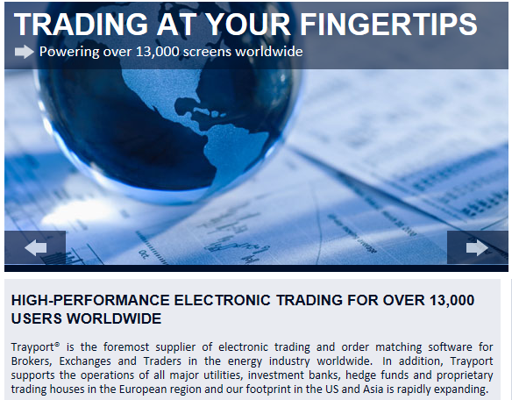
Example #3: Finance trading platform
F# + C# for Trading Front End
Leverage F#’s features:
- extensive type system
- asynchronous workflows, agents and immutable types
- rich pattern matching and parser support
“Experienced F# developers regularly solve problems in days that would take weeks using more traditional languages…solving complex problems in an elegant and highly maintainable manner”
Phil Trelford, Trayport
Time to Market
Complexity

Slide 77
Example #4: F# for Quant Consulting
Our bids for tendered contracts in quantitative finance are regularly half the price of competitors because of the increased productivity we get from F#.
We are regularly able to deliver correct, robust, performant solutions on-time, which is what our customers value most.
Daniel Egloff, QuantAlea Consulting, Zurich
Efficiency
Time to Market
Correctness
http://fsharp.org/testimonials

Slide 78
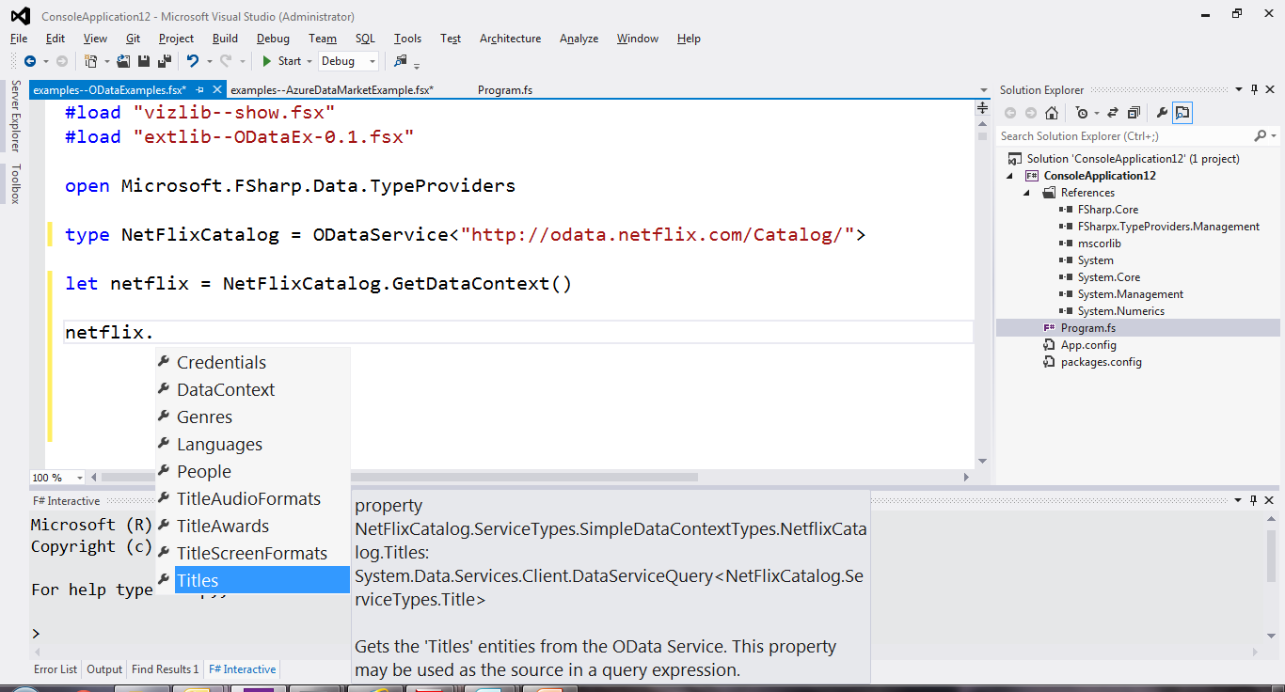
OData

